Slide 1
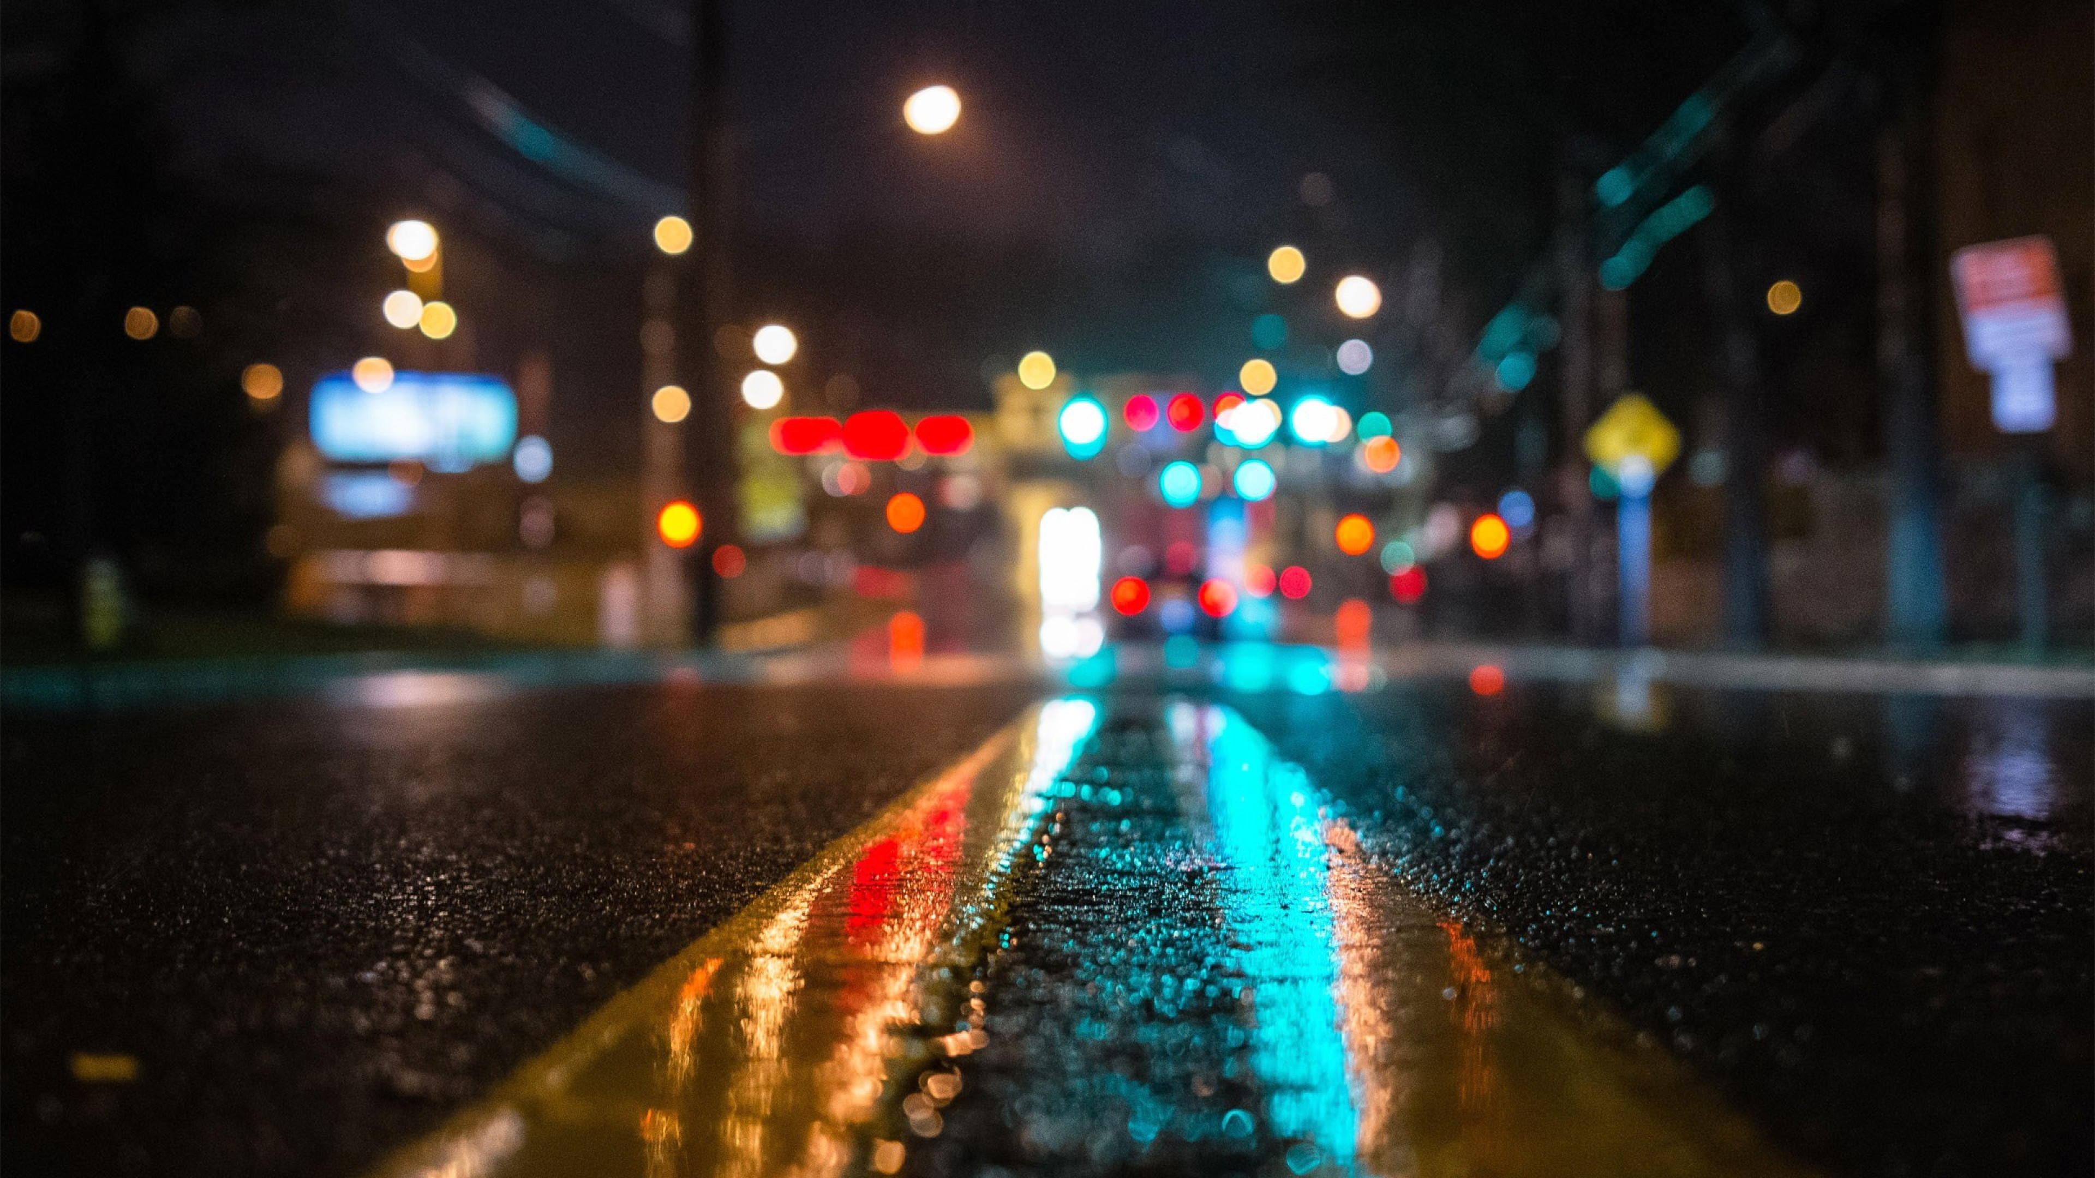
NATURAL VISION MOTOCYLCE

